Slide 1
??
Internal Project
Web report
25 July 2016

Slide 2
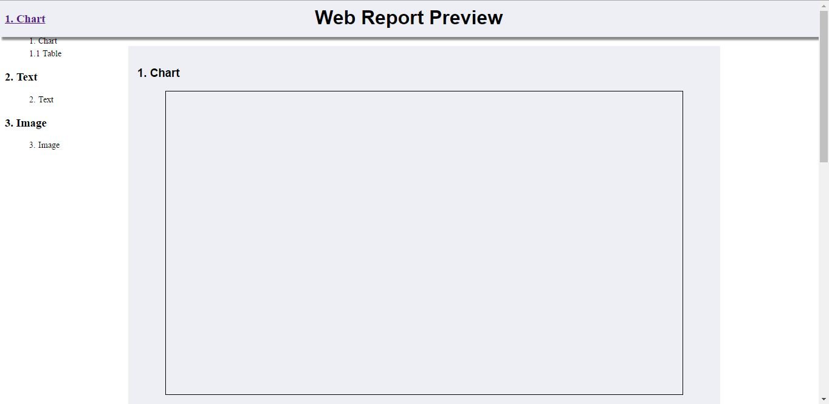
Comment-1
While opening the web report in any browser it's looking like all navigation panel and headings are merging with each other. When we are sliding down it looking normally.

Slide 3
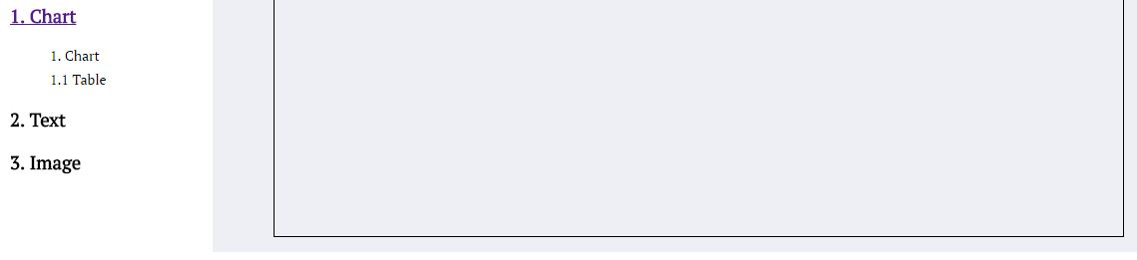
Comment-2
In Charts and table, images should be start the sub sections with 1.1 & 2.1 etc., and not to be mentions with main sections (example 1.chart).
Should be remove these column

Slide 4
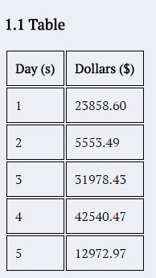
Comment-3
We need guidelines how to edit format and adjust according to our requirement in web report. Example: How to increase the columns and rows in the below table?

Slide 5
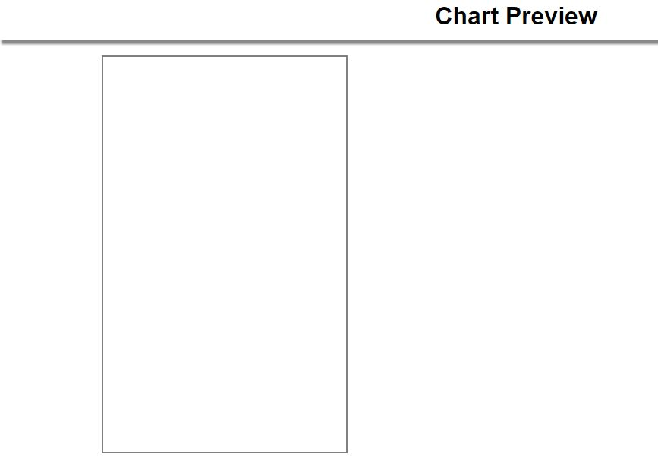
Comment-4
In these below chart we are not able to understand the chart preview.

Slide 6

Comment-5
We need a separate first page for the logo. Also please provide us company and client logo in the report. Example as shown below screen shot.

Slide 7
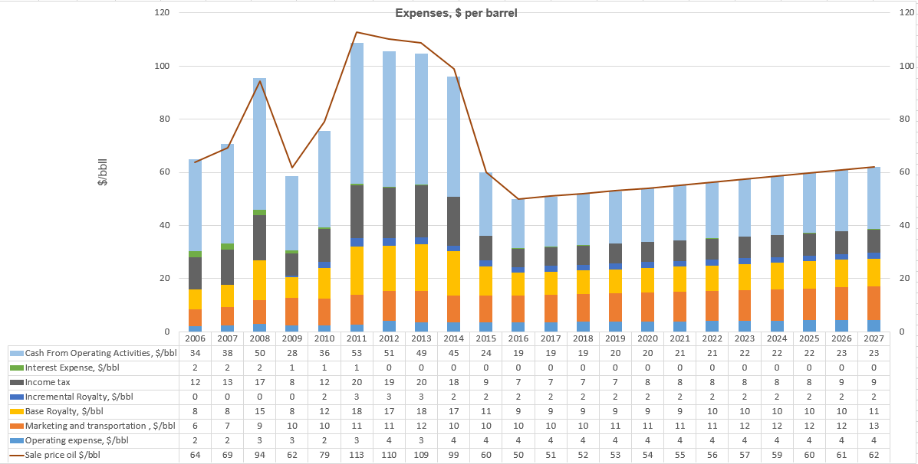
Comment-6
We need a hyperlink option to open the headings separately.

Slide 8
A Good Chart Format
We can use this as line chart, as bar chart or combination chart.

Slide 9
THANK YOU
For the opportunity to serve!

Slide 10
Document Revision History
01 | PRE-0001-01 Web report preview comments | 22 July 2016 |  | GSY | VA | ?
Rev | Description | Date |  | Author | Checked | Approved
Document No: |  |  | Client Ref:
PRE-0001-01 Web report preview comments |  |  | n/a

